Slide 1
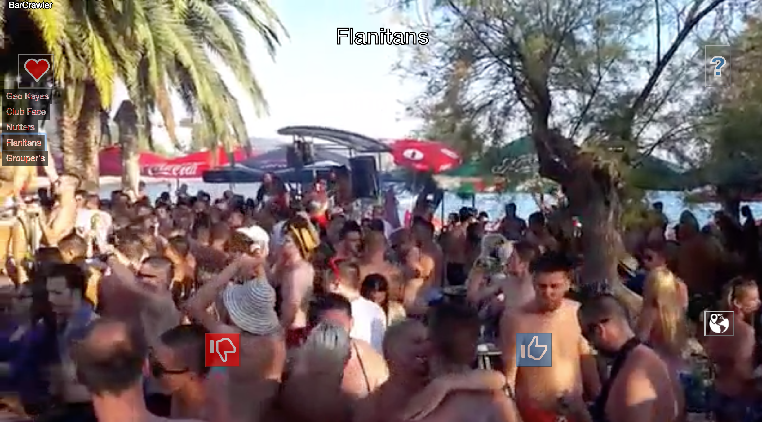
BarCrawler

Slide 2
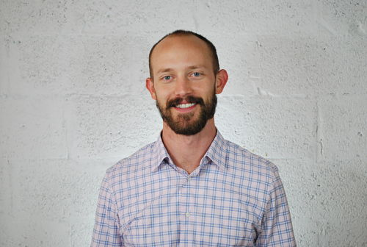
This is me
My name is Nick Borbe

Slide 3
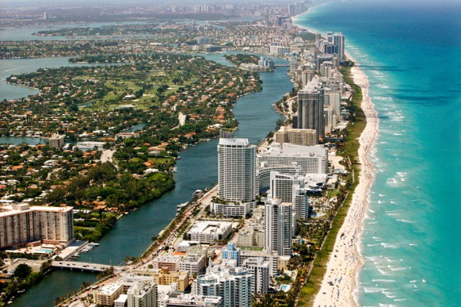

Slide 4
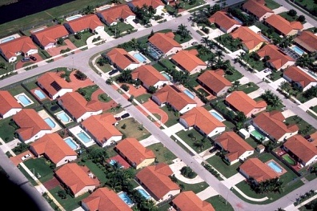
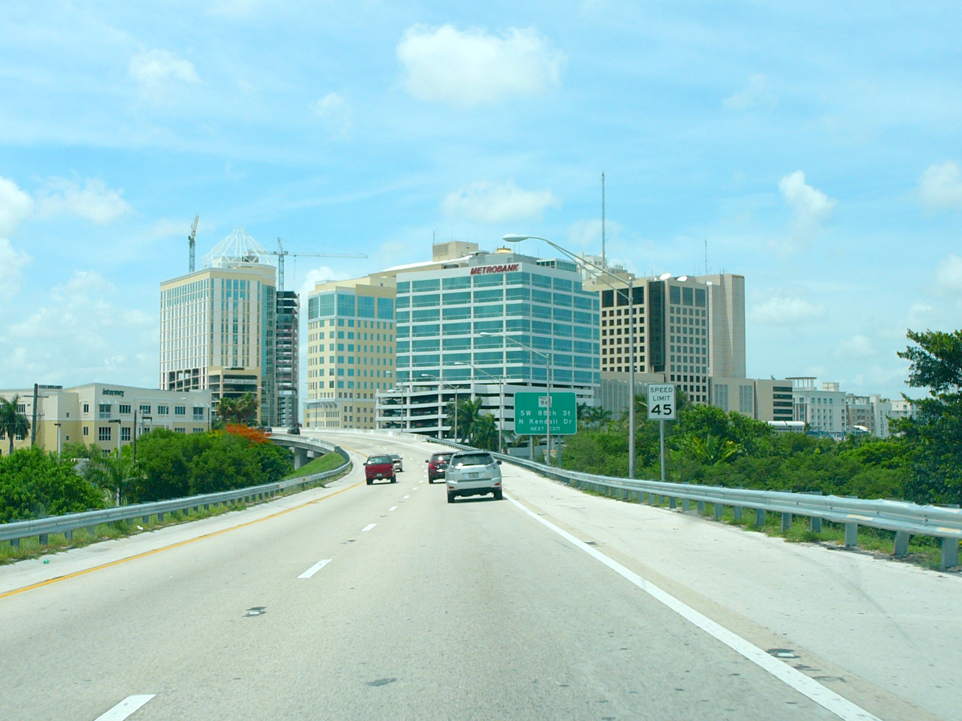
Kendall has a different kind of beauty

Slide 5
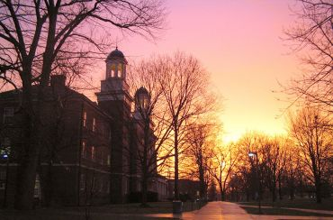
Denison University

Slide 6

This is a picture of me in college

Slide 7

This is what a paralegal looks like

Slide 8

This is the only way I know how to express happiness

Slide 9
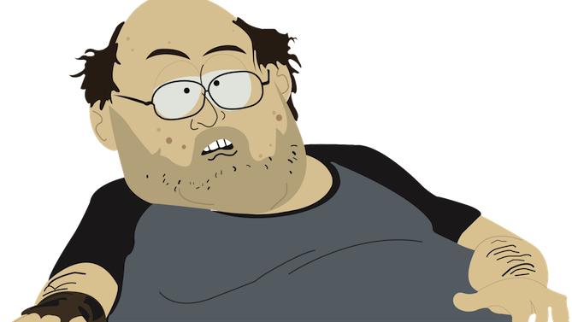
This is what web developers look like, right?

Slide 10
This guy

Slide 12


Slide 13
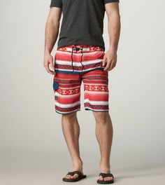
Don’t be like me. Don’t show up in swim trunks.

Slide 14
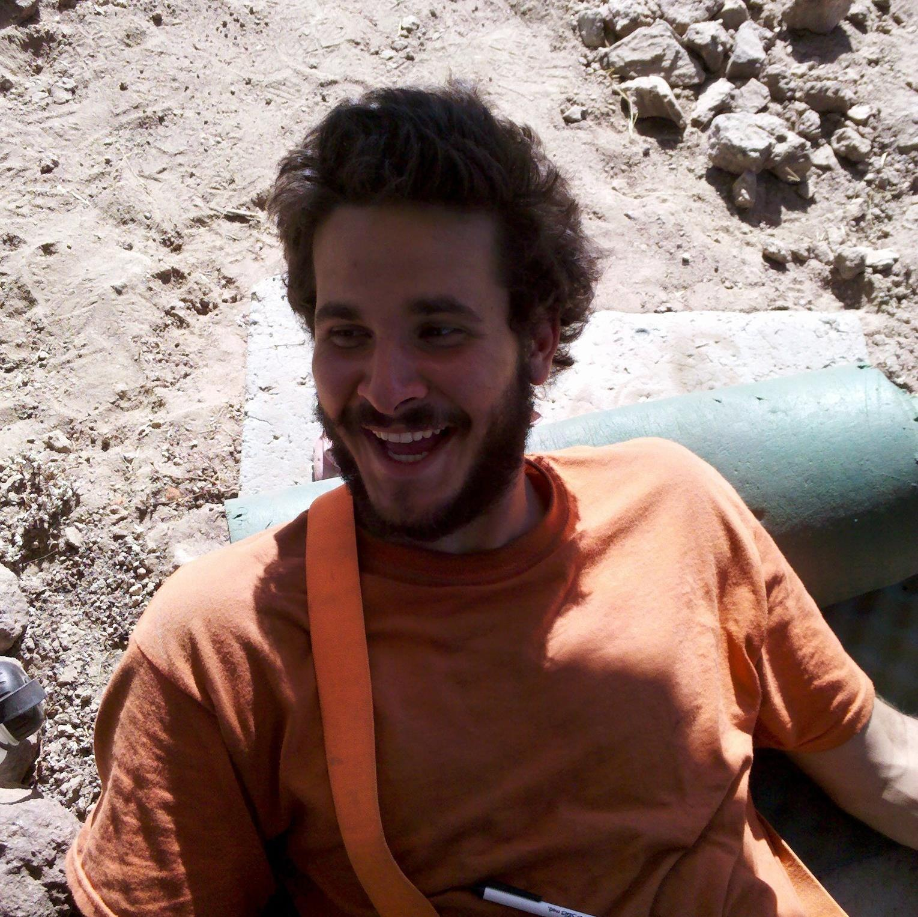
Dude, don’t even worry, this place is totally casual.

Slide 15
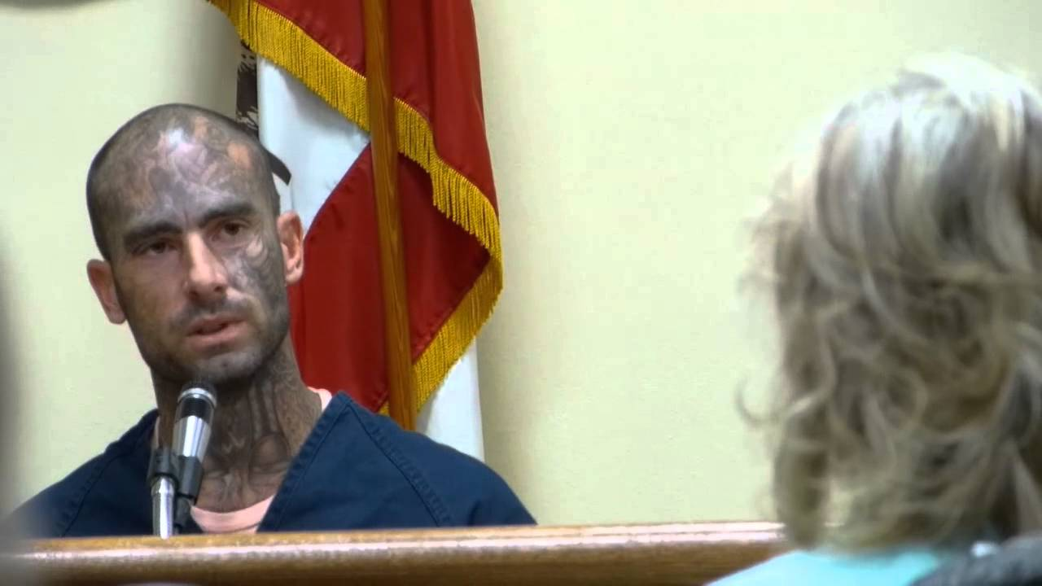
Trust me, you can believe everything I say.

Slide 16


Slide 17







Technologies

Slide 18

How It Works
Reload
Reload
Reload
Reload

Slide 19




Slide 20

Thanks for listening. Here’s a picture of a cat for your patience.

